Slide 1

Maven
June 2016

Slide 2
Maven - Repositories
In Maven terminology, a repository is a place i.e. directory where all the project jars, library jar, plug-in or any other project specific artifacts are stored and can be used by Maven easily.
Maven repository are of three types
local
central
remote
Notes:
This course covers integration basics that are important to understand for all developers working on integration projects.

Slide 3
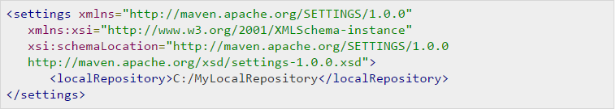
Local Repository
Maven local repository is a folder location on your machine. It gets created when you run any maven command for the first time.
Maven local repository keeps your project's all dependencies (library jars, plug-in jars etc). When you run a Maven build, then Maven automatically downloads all the dependency jars into the local repository. It helps to avoid references to dependencies stored on remote machine every time a project is build.
Maven local repository by default get created by Maven in %USER_HOME% directory. To override the default location, mention another path in Maven settings.xml file available at %M2_HOME%\conf directory. When you run Maven command, Maven will download dependencies to your custom path.
Notes:
This course covers integration basics that are important to understand for all developers working on integration projects.

Slide 4
Central Repository
Maven central repository is repository provided by Maven community. It contains a large number of commonly used libraries.
When Maven does not find any dependency in local repository, it starts searching in central repository using following URL:http://repo1.maven.org/maven2/
Key concepts of Central repository
This repository is managed by Maven community.
It is not required to be configured.
It requires internet access to be searched.
To browse the content of central maven repository, maven community has provided a URL: http://search.maven.org/#browse. Using this library, a developer can search all the available libraries in central repository.
Notes:
This course covers integration basics that are important to understand for all developers working on integration projects.

Slide 5
Maven - Repositories
In Maven terminology, a repository is a place i.e. directory where all the project jars, library jar, plug-in or any other project specific artifacts are stored and can be used by Maven easily.
Maven repository are of three types
local
central
remote
Notes:
This course covers integration basics that are important to understand for all developers working on integration projects.

Slide 6
Remote Repository
Sometime, Maven does not find a mentioned dependency in central repository as well then it stopped build process and output error message to console. To prevent such situation, Maven provides concept of Remote Repository which is developer's own custom repository containing required libraries or other project jars.
For example, using below mentioned POM.xml, Maven will download dependency (not available in central repository) from Remote Repositories mentioned in the same pom.xml.
Notes:
This course covers integration basics that are important to understand for all developers working on integration projects.

Slide 7
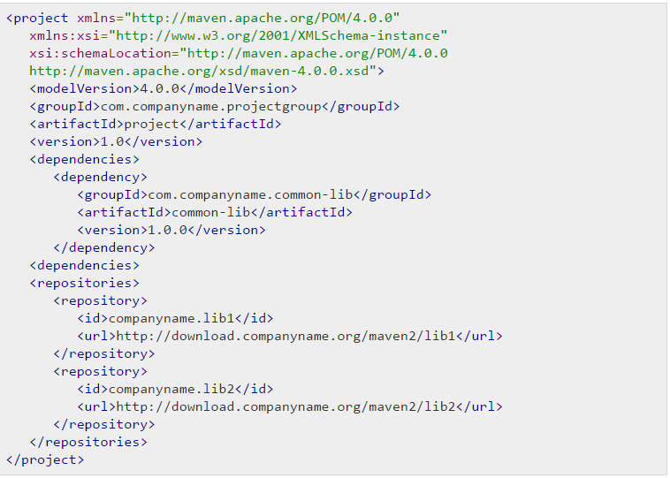
Remote Repository
Notes:
This course covers integration basics that are important to understand for all developers working on integration projects.

Slide 8
Maven Dependency Search Sequence
When we execute Maven build commands, Maven starts looking for dependency libraries in the following sequence:
Step 1 - Search dependency in local repository, if not found, move to step 2 else if found then do the further processing.
Step 2 - Search dependency in central repository, if not found and remote repository/repositories is/are mentioned then move to step 4 else if found, then it is downloaded to local repository for future reference.
Step 3 - If a remote repository has not been mentioned, Maven simply stops the processing and throws error (Unable to find dependency).
Step 4 - Search dependency in remote repository or repositories, if found then it is downloaded to local repository for future reference otherwise Maven as expected stop processing and throws error (Unable to find dependency).
Maven - External Dependencies Maven - External Dependencies
Notes:
This course covers integration basics that are important to understand for all developers working on integration projects.

Slide 9
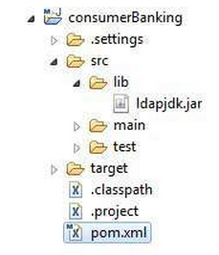
Maven - External Dependencies
Now as you know Maven does the dependency management using concept of Maven Repositories. But what happens if dependency is not available in any of remote repositories and central repository? Maven provides answer for such scenario using concept of External Dependency.
For an example, let us do the following changes to project created in Maven Creating Project section.
Add lib folder to src folder. Copy any jar into the lib folder. We've used ldapjdk.jar, which is a helper library for LDAP operations. Now our project structure should look like following:
Notes:
This course covers integration basics that are important to understand for all developers working on integration projects.

Slide 10
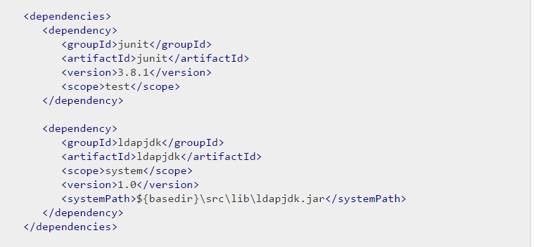
Maven - External Dependencies
Here you are having your own library specific to project, which is very usual case and it can contain jars which may not be available in any repository for maven to download from. If your code is using this library with Maven then Maven build will fail because it cannot download or refer to this library during compilation phase.
To handle the situation, let's add this external dependency to mavenpom.xml using following way.
Notes:
This course covers integration basics that are important to understand for all developers working on integration projects.

Slide 11
Maven - External Dependencies
Look at the second dependency element under dependencies in above example which clears following key concepts about External Dependency.
External dependencies (library jar location) can be configured in pom.xml in same way as other dependencies.
Specify groupId same as name of the library.
Specify artifactId same as name of the library.
Specify scope as system.
Specify system path relative to project location.
Hope now you are clear about external dependencies and you will be able to specify external dependencies in your Maven project.
Notes:
This course covers integration basics that are important to understand for all developers working on integration projects.

Slide 12
Installing 3rd party JARs
Although rarely, but sometimes you will have 3rd party JARs that you need to put in your local repository for use in your builds, since they don't exist in any public repository like Maven Central. The JARs must be placed in the local repository in the correct place in order for it to be correctly picked up by Apache Maven. To make this easier, and less error prone, we have provide a goal in the maven-install-plugin which should make this relatively painless. To install a JAR in the local repository use the following command:
mvn install:install-file -Dfile=<path-to-file> -DgroupId=<group-id> \ - DartifactId=<artifact-id> -Dversion=<version> -Dpackaging=<packaging>
If there's a pom-file as well, you can install it with the following command:
mvn install:install-file -Dfile=<path-to-file> -DpomFile=<path-to-pomfile>
With version 2.5 of the maven-install-plugin it gets even better. If the JAR was built by Apache Maven, it'll contain a pom.xml in a subfolder of the META-INF directory, which will be read by default. In that case, all you need to do is:
mvn install:install-file -Dfile=<path-to-file>

Slide 13
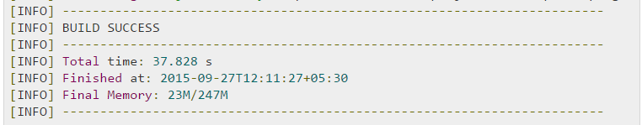
Maven - Project Documents
This tutorial will teach you how to create documentation of the application in one go. So let's start, go to C:/MVN directory where you had created your javaconsumerBanking application. Open consumerBanking folder and execute the following mvn command.
C:\MVN>mvn site
Maven will start building the project.
Notes:
This course covers integration basics that are important to understand for all developers working on integration projects.

Slide 14
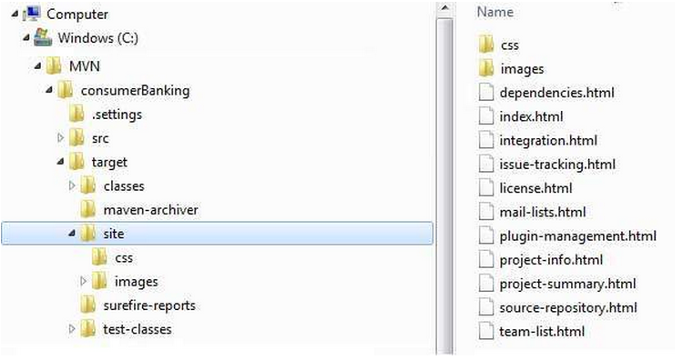
Maven - Project Documents
That's it. Your project documentation is ready. Maven has created a site within target directory.
Open C:\MVN\consumerBanking\target\site folder. Click on index.html to see the documentation.

Slide 15
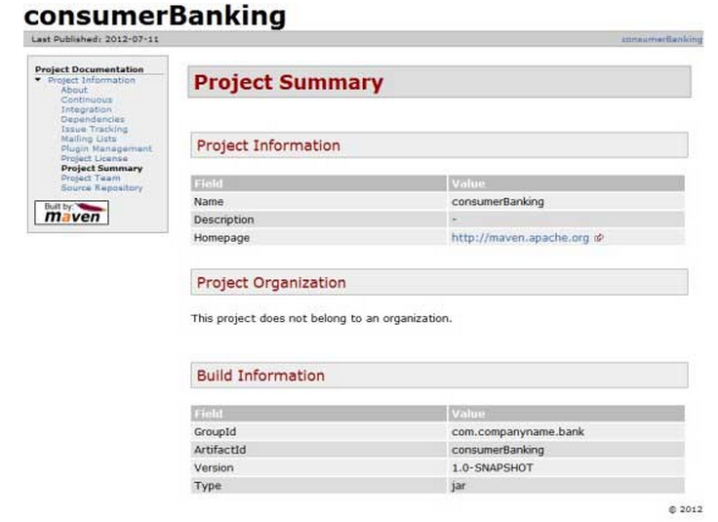
Maven - Project Documents

Slide 16
Setting up Web Server: Tomcat
Apache Tomcat is an open source software implementation of the JavaServer Pages and Servlet technologies and can act as a standalone server for testing JSP and Servlets and can be integrated with the Apache Web Server. Here are the steps to setup Tomcat on your machine:
Download latest version of Tomcat from http://tomcat.apache.org/.
Once you downloaded the installation, unpack the binary distribution into a convenient location.
For example in C:\apache-tomcat-5.5.29 on windows
Create CATALINA_HOME environment variable pointing to these locations.
CATALINA_HOME = C:\apache-tomcat-5.5.29
Notes:
This course covers integration basics that are important to understand for all developers working on integration projects.

Slide 17
Setting up Web Server: Tomcat
Tomcat can be started by executing the following commands on windows machine:
%CATALINA_HOME%\bin\startup.bat
or
C:\apache-tomcat-5.5.29\bin\startup.bat
After a successful startup, the default web applications included with Tomcat will be available by visiting http://localhost:8080/. If everything is fine then it should display following result:
Notes:
This course covers integration basics that are important to understand for all developers working on integration projects.

Slide 18
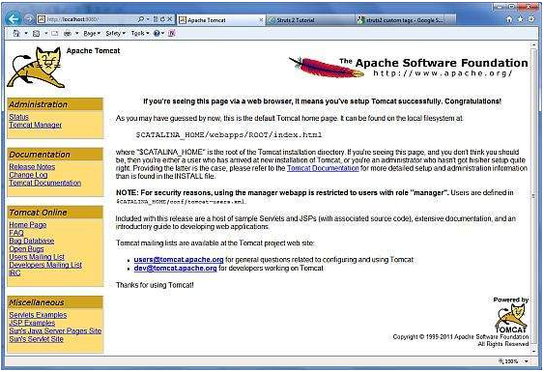
Setting up Web Server: Tomcat
Notes:
This course covers integration basics that are important to understand for all developers working on integration projects.

Slide 19
Creating Users and Passwords
A very easy method of authenticating users with Tomcat involves creating usernames, passwords, and roles in the tomcat-users.xml file.
This file is stored in <Tomcat-installation-directory>/conf.
Everyone is familiar with usernames and passwords, but what are roles? Roles are logical ways to describe groups of users who have similar responsibilities, such as manager or databaseAdmin. Example below shows a tomcat-users.xml file that creates two roles and two users with two aptly named XML elements: role and user.
<?xml version="1.0" encoding="UTF-8"?>
<tomcat-users>
<role rolename="tomcat"/>
<role rolename="manager"/>
<role rolename="admin"/>
<role rolename="manager-gui"/>
<user username="abcd" password="abcd" roles="standard,manager,admin,manager-gui,manager-script" />
</tomcat-users>
Notes:
This course covers integration basics that are important to understand for all developers working on integration projects.

Slide 20

Maven - Web Application
To create a simple java web application, we'll use maven-archetype-webapp plugin. So let's open command console, go the C:\MVN directory and execute the following mvn command.
C:\MVN>mvn archetype:generate -DgroupId=com.companyname.automobile -DartifactId=trucks -DarchetypeArtifactId=maven-archetype-webapp -DinteractiveMode=false
Maven will start processing and will create the complete web based java application project structure.
Notes:
This course covers integration basics that are important to understand for all developers working on integration projects.

Slide 21
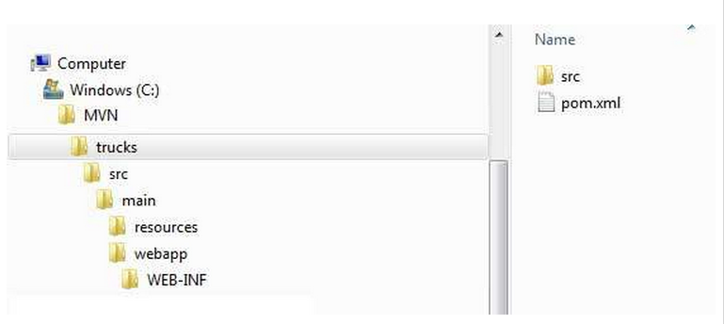
Maven - Web Application
Now go to C:/MVN directory. You'll see a java application project created named trucks (as specified in artifactId).
Notes:
This course covers integration basics that are important to understand for all developers working on integration projects.

Slide 22
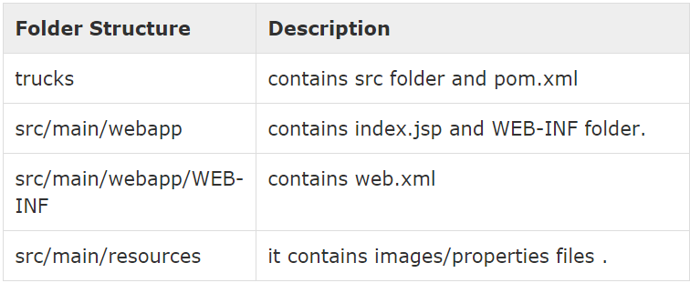
Maven - Web Application
Maven uses a standard directory layout. Using above example, we can understand following key concepts
Notes:
This course covers integration basics that are important to understand for all developers working on integration projects.

Slide 23
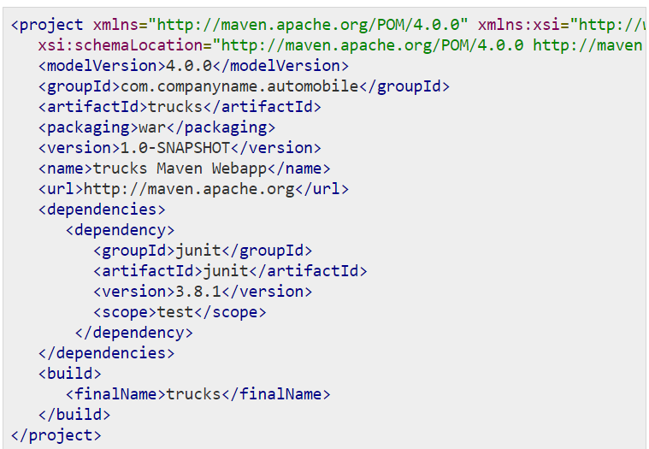
Maven - Web Application - POM
Notes:
This course covers integration basics that are important to understand for all developers working on integration projects.

Slide 24
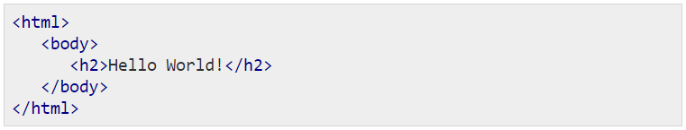
Maven - Web Application
Maven also created a sample JSP Source file
Open C:\ > MVN > trucks > src > main > webapp > folder, you will see index.jsp.
Notes:
This course covers integration basics that are important to understand for all developers working on integration projects.

Slide 25
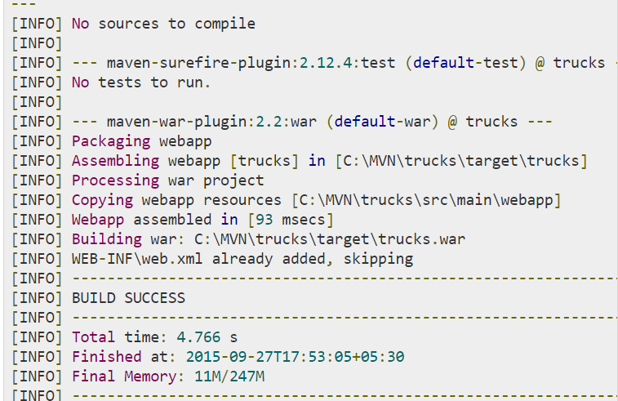
Build Web Application
Let's open command console, go the C:\MVN\trucks directory and execute the following mvn command.
C:\MVN\trucks>mvn clean package
Maven will start building the project.
Notes:
This course covers integration basics that are important to understand for all developers working on integration projects.

Slide 26
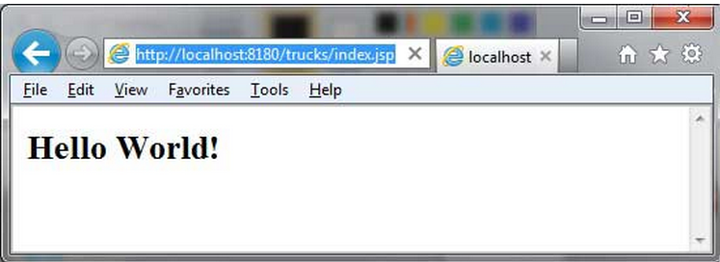
Deploy Web Application
Now copy the trucks.war created in C:\ > MVN > trucks > target > folder to your webserver webapp directory and restart the webserver.
Test Web Application
Run the web-application using URL : http://<server-name>:<port-number>/trucks/index.jsp
Verify the output.
Notes:
This course covers integration basics that are important to understand for all developers working on integration projects.

Slide 27
Maven - Eclispe IDE
Eclipse provides an excellent plugin m2eclipse which seamlessly integrates Maven and Eclipse together. Some of features of m2eclipse are listed below
You can run Maven goals from Eclipse.
You can view the output of Maven commands inside the Eclipse using its own console.
You can update maven dependencies with IDE.
You can Launch Maven builds from within Eclipse.
It does the dependency management for Eclipse build path based on Maven's pom.xml.
It resolves Maven dependencies from the Eclipse workspace without installing to local Maven repository (requires dependency project be in same workspace).
It automatic downloads required dependencies and sources from the remote Maven repositories.
It provides wizards for creating new Maven projects, pom.xml and to enable Maven support on existing projects
It provides quick search for dependencies in remote Maven repositories
Notes:
This course covers integration basics that are important to understand for all developers working on integration projects.

Slide 28
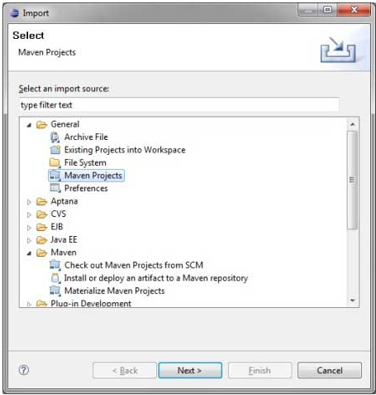
Maven - Eclispe IDE
Import a maven project in Eclipse
Open Eclipse.
Select File > Import > option.
Select Maven Projects Option. Click on Next Button.
Notes:
This course covers integration basics that are important to understand for all developers working on integration projects.

Slide 29
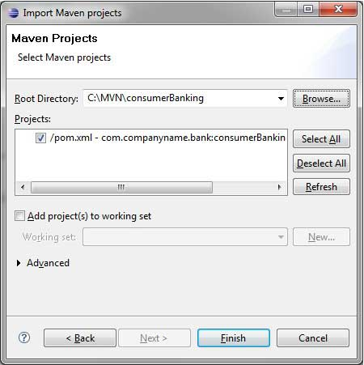
Maven - Eclispe IDE
Select Project location, where a project was created using Maven. We've create a Java Project consumerBanking.
Click Finish Button.
Notes:
This course covers integration basics that are important to understand for all developers working on integration projects.

Slide 30
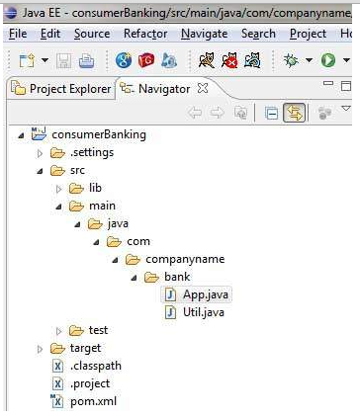
Maven - Eclispe IDE
Now, you can see the maven project in eclipse.
Notes:
This course covers integration basics that are important to understand for all developers working on integration projects.

Slide 31
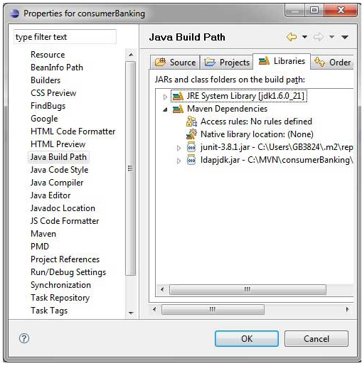
Maven - Eclispe IDE
Now, have a look at consumerBanking project properties. You can see that Eclipse has added Maven dependencies to java build path.
Notes:
This course covers integration basics that are important to understand for all developers working on integration projects.

Slide 32
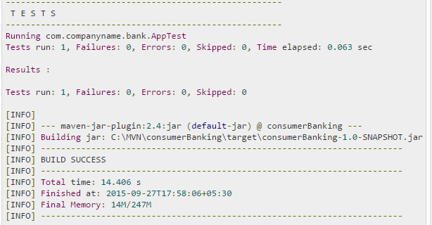
Maven - Eclispe IDE
Now, Its time to build this project using maven capability of eclipse.
Right Click on consumerBanking project to open context menu.
Select Run as option
Then maven package option
Maven will start building the project. You can see the output in Eclipse Console
Notes:
This course covers integration basics that are important to understand for all developers working on integration projects.

Slide 33
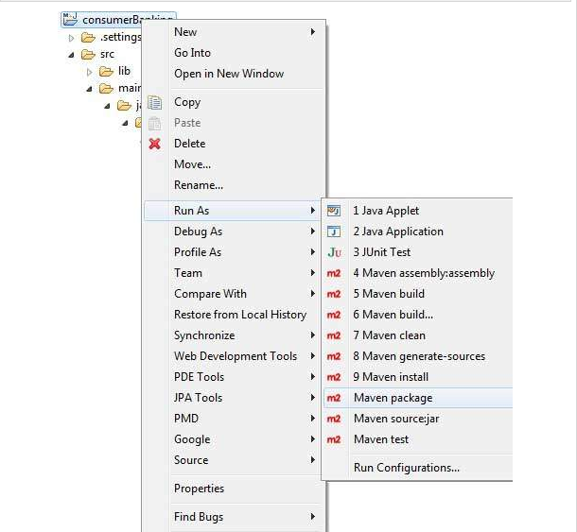
Maven - Eclispe IDE
Now, right click on App.java. Select Run As option. Select As Java Application.
You will see the result
Notes:
This course covers integration basics that are important to understand for all developers working on integration projects.

Slide 34
References
http://www.tutorialspoint.com/maven/maven_quick_guide.htm
http://www.tutorialspoint.com/jsp/jsp_environment_setup.htm

